Slide 1
Everyday Statistics
Common significance/hypotheses tests
February 2019

Slide 2
What is a null hypothesis
Hypothesis testing was introduced by Ronald Fisher, Jerzy Neyman, Karl Pearson and Pearson’s son, Egon Pearson
Hypothesis testing is a statistical method that is used in making statistical decisions using experimental data
The null hypothesis (H₀) is a hypothesis which the researcher tries to disprove, rectify or nullify. ‘NULL’ often refers to the common view of something
Alternative hypothesis (H₁) is what the researcher really thinks is the cause of the phenomenon
Example:
H₁ : Tomato plants exhibit a higher rate of growth when planted in compost rather than in soil.
H₀ : Tomato plants show no difference in growth rates when planted in compost rather than soil.

Slide 3
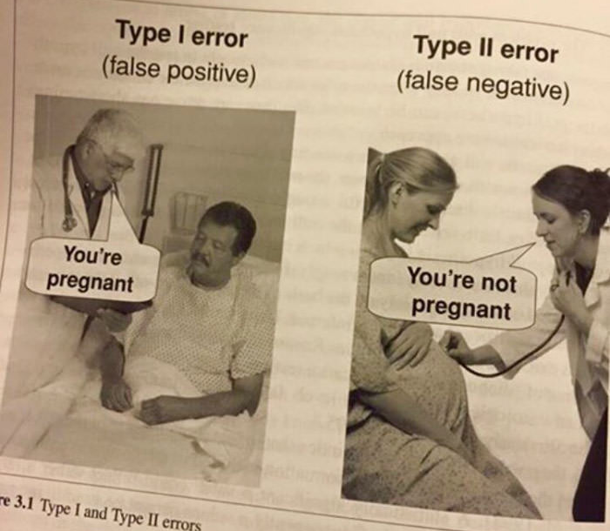
Why do we test a null hypothesis?
Science is based on the logic of falsification
Types of errors in hypothesis testing
Type I error
Type II error
Which of these errors is more dangerous?
In almost all cases that exist in nature not rejecting the null hypothesis (Type II) is more dangerous

Slide 4
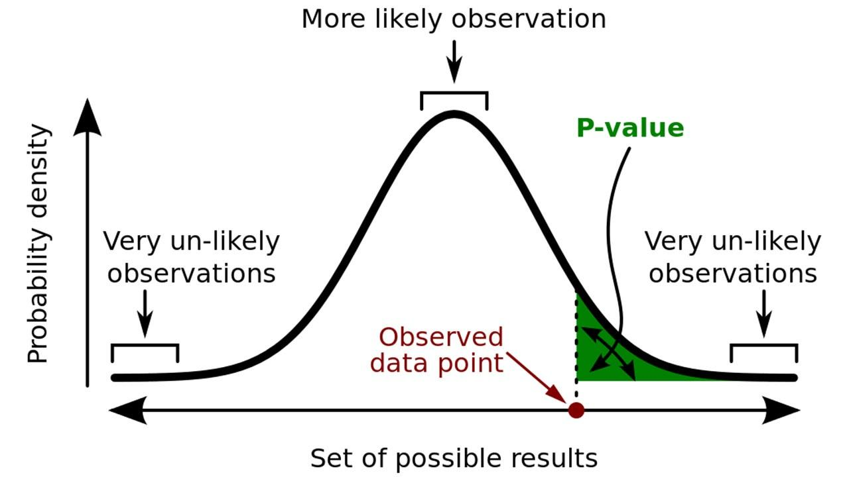
Significance Level (alpha)
The significance level, also denoted as alpha or α, is the probability of rejecting the null hypothesis when it is true. For example, a significance level of 0.05 indicates a 5% risk of concluding that a difference exists when there is no actual difference.
The significance level determines how far out from the null hypothesis value we'll draw that line on the graph. To graph a significance level of 0.05, we need to shade the 5% of the distribution that is furthest away from the null hypothesis.\
P-values are the probability of obtaining an effect at least as extreme as the one in your sample data, assuming the truth of the null hypothesis.
http://blog.minitab.com/blog/adventures-in-statistics-2/understanding-hypothesis-tests-significance-levels-alpha-and-p-values-in-statistics

Slide 5
Hypothesis testing is a method of testing a hypothesis about a parameter in a population using data from a selected sample
Hypothesis Testing
1 dependent variable
No
Yes
Test of mean
Test of variance
Test of Probability
An insurance company would like to understand if the average claim amount has changed since last year
A Bank wants to understand if the sample obtained from satisfaction survey represents population on gender and age group
For a direct mail campaign, bank wants to understand if probability of response increases with increasing mail send
Known Variance
Test variance of sample to population
Two sample test for equality of variance
No
2 categories
No
Yes
No*
Parametric
Yes
N>30
No
Yes
Yes
Z Test
T Test
Chi Square Test
F Test
Kruskal Wallis
Binomial Test
Multinomial Test
MANOVA
* if data is normally distributed

Slide 6
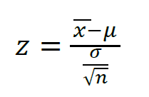
Z-test
Z test is used when variance is known. Variance is the expected value of the squared variation from the mean
If the sample size is large (N>30 based on standard text books) the sample deviation is considered reflective of the population. In such cases a Z-test can be used
Example:
A principle in a school claims that student are above average intelligence. A random sample of 30 students’ IQ scores have a mean of 112.5. IS there sufficient evidence to prove the claim. Mean population IQ is 100 with standard deviation of 15
H₀: mean=100; H₁: mean>100
State alpha level: 0.05 and calculate Z₀ = 1.64 (https://www.socscistatistics.com/tests/ztest/zscorecalculator.aspx )
Calculate Z value: = (112.5-100)/(15/√30) = 4.56
If the first Z₁>Z₀ then null hypothesis can be rejected

Slide 7
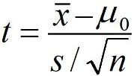
T-test
A t-test’s statistical significance indicates whether or not the difference between two groups’ averages most likely reflects a “real” difference in the population from which the groups were sampled
Example:
A report from 6 years ago indicated that the average gross salary for a BA was $98,873. The Bureau of Labor Statistics wishes to test this figure against current salaries to see if it is statistically different from old ones. Based on this sample we found, s=$14,985. In this case BLS will take a sample of 12 current salaries where mean is $79,180
H₀: mean = 69,873; H₁: mean != 69,873
Determine type of test: In this case as value can be larger or lower it is a 2 tailed test
State alpha level = 0.5 and find t₀ for df=11 : t₀ = +/- 2.200985
Calculate t value: = (79180-69873)/(14985/√12) = 4.56 = 2.15
If t>+t₀ or t<-t₀ then reject null hypothesis, i.e., as t<t₀ the null hypothesis cannot be rejected

Slide 8
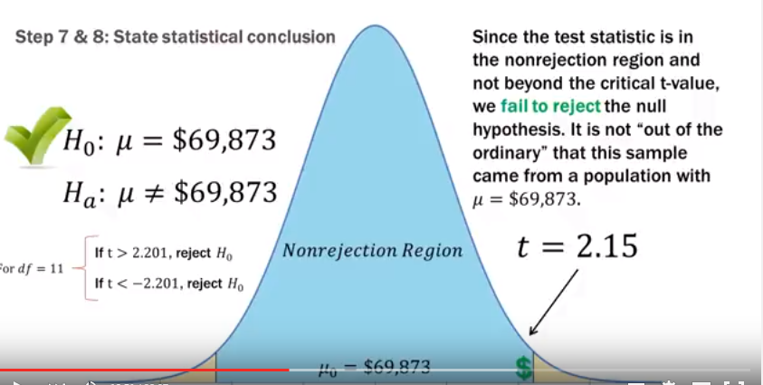
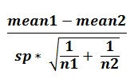
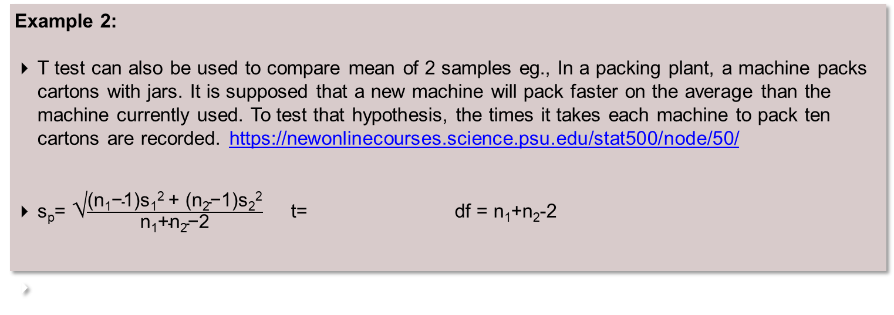
T-test contd.
Example 2:
T test can also be used to compare mean of 2 samples eg., In a packing plant, a machine packs cartons with jars. It is supposed that a new machine will pack faster on the average than the machine currently used. To test that hypothesis, the times it takes each machine to pack ten cartons are recorded. https://newonlinecourses.science.psu.edu/stat500/node/50/
s_{p}= √$\frac{\text{(}\text{n}\text{1}\text{−1)}\text{s}\text{1}\text{2 }\text{+ (}\text{n}\text{2}\text{−1)}\text{s}\text{2}\text{2}}{\text{n}\text{1}\text{+}\text{n}\text{2}\text{−2}}$ t= df = n₁+n₂-2

Slide 9
Chi-Square Test (One Way Tables)
The Chi Square distribution is the distribution of the sum of squared standard normal deviates
Common tests using Chi Square distribution are:
One-Way tables: tests of deviations of differences between theoretically expected and observed frequencies
If we need to check if a dice in unbiased, i.e., the probability of getting a 6 is 1/6 in a dice rolled 36 times
Now just based on chance there is a high chance that number of times you get 6 is not 6
For a chi-square value of 5.33 and a degree of freedom of 5 (no. of categories-1) the probability of value being greater than 5.33 in 0.377 (http://onlinestatbook.com/2/calculators/chi_square_prob.html) which means that the null hypothesis that the dice is fair cannot be rejected
Outcome | Expected | Observed | (E-O)^2/E
1 | 6 | 8 | 0.67
2 | 6 | 5 | 0.17
3 | 6 | 9 | 1.50
4 | 6 | 2 | 2.67
5 | 6 | 7 | 0.17
6 | 6 | 5 | 0.17
 |  | Sum: | 5.33

Slide 10


Chi-Square Test (Contingency Tables)
Contingency tables: relationship between categorical variables
Example: Out of a population of 100 people we need to see if littering behavior is affected by gender. There can be 4 cases that exist:
Male who litters
Male who do not litter
Female who litters
Female who do not litter
Observed Value:
Expected Value:
 | Do Not Litter | Litter | Σ
Male | 18 | 7 | 25
Female | 42 | 33 | 75
Σ | 60 | 40 | 100
 | Do Not Litter | Litter | Σ
Male | 15 | 10 | 25
Female | 45 | 30 | 75
Σ | 60 | 40 | 100
Again using the below equation we get the chi value as 2.0
$\frac{Row Total ∗Column Total}{Total Count} = \frac{25∗60}{100} =$15
Degree of freedom is (#rows-1)*(#columns-1)
So with chi value as 2.0 and df=1 then probability is 0.1573 which means that the null hypothesis can’t be rejected

Slide 11
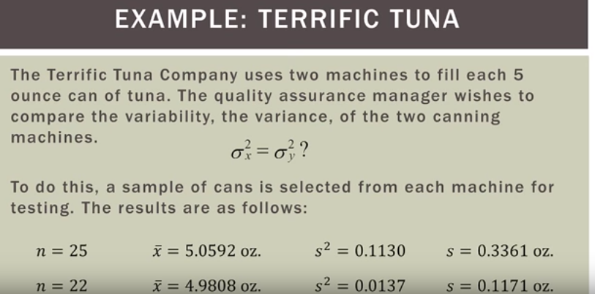
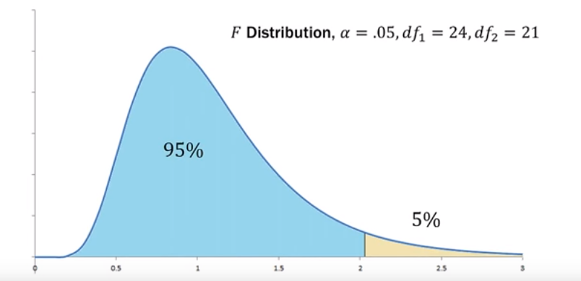
F Ratio
When we want to compare 2 samples and see if they are statistically similar or from the same population we use a F-Test
F-Test compares the variance between the 2 samples
F ratio = s₁²/s₂²
http://www.statskingdom.com/220VarF2.html
F Ratio forms the basis of ANOVA

Slide 12
Kruskal Wallis Test
The Kruskal Wallis test is the non parametric alternative to the One Way ANOVA. Non parametric means that the test doesn’t assume your data comes from a particular distribution.
The Kruskal-Wallis test is most commonly used when there is one attribute variable and one measurement variable, and the measurement variable does not meet the assumptions of ANOVA (normality and homoscedasticity). Like most non-parametric tests, it is performed on ranked data, so the measurement observations are converted to their ranks in the overall data set
Non parametric tests are not usually common in business cases and most of the information collected make it parametric in nature
For further details: https://www.statisticshowto.datasciencecentral.com/kruskal-wallis/

Slide 13
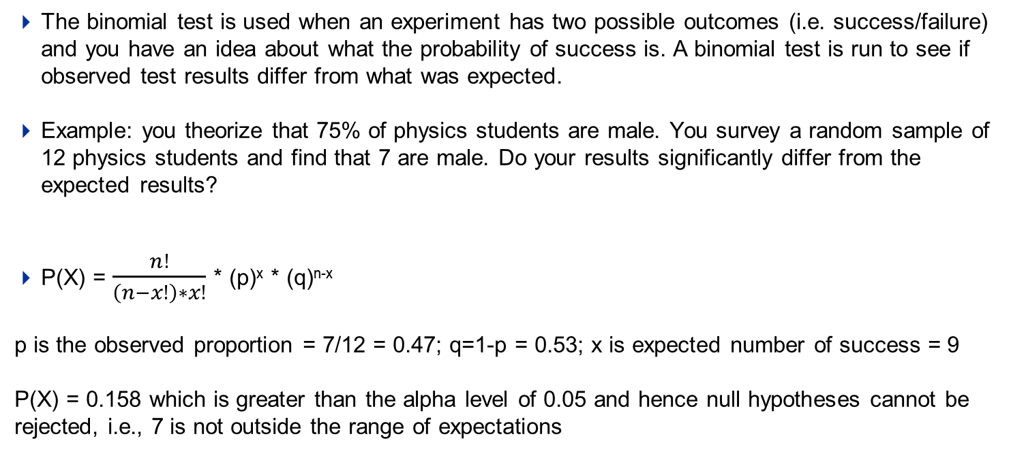
Binomial Test
The binomial test is used when an experiment has two possible outcomes (i.e. success/failure) and you have an idea about what the probability of success is. A binomial test is run to see if observed test results differ from what was expected.
Example: you theorize that 75% of physics students are male. You survey a random sample of 12 physics students and find that 7 are male. Do your results significantly differ from the expected results?
P(X) = $\frac{n!}{\left(n−x!\right)∗x!}$ * (p)^{x} * (q)^{n-x}
p is the observed proportion = 7/12 = 0.47; q=1-p = 0.53; x is expected number of success = 9
P(X) = 0.158 which is greater than the alpha level of 0.05 and hence null hypotheses cannot be rejected, i.e., 7 is not outside the range of expectations

Slide 14
ANOVA (Analysis of Variance)
Limiting ourselves to comparing only 2 samples is well… limiting
We could run multiple t-tests but the error gets compounded
If confidence is 0.05 then on doing 3 t tests the error gets compounded and the new confidence is 0.95*0.95*0.95 = .857
Types of ANOVA test:
Type | Details | Examples
One-way ANOVA | used when you want to test two or more groups to see if there’s a difference between them | Suppose the National Transportation Safety Board (NTSB) wants to examine the safety of compact cars, midsize cars, and full-size cars. It collects a sample of three for each of the treatments (cars types). Using the hypothetical data provided below, test whether the mean pressure applied to the driver’s head during a crash test is equal for each types of car. http://cba.ualr.edu/smartstat/topics/anova/example.pdf
Two-way ANOVA without replication | used when you have one group and you’re double-testing that same group. For example, you’re testing one set of individuals before and after they take a medication to see if it works or not | A group of students go to 3 different test centers to give tests. We need to study if there is an impact of the test center on the results of the student
Two-way ANOVA with replication | Two groups, and the members of those groups are doing more than one thing. For example, two groups of patients from different hospitals trying two different therapies. | Effectiveness of fertilizer on 3 different plant groups need to be analyzed across number of feeding periods in a day to find out the most effective plant feed combination

Slide 15
MANOVA (Multivariate Analysis of Variance)
The basic application of MANOVA is to identify if there is any difference in various categories of subjects in terms of two or more dependent variables
No. of dependent variables should at least be 2.
At least one of the independent variable should be categorical
Dependent variables should be normal in nature and have linear relationships with each other
MANOVA is most effective when dependent variables are moderately correlated (.4 - .7). If dependent variables are too highly correlated it could be assumed that they may be measuring the same variable.
Example:
we may conduct a study where we try two different textbooks, and we are interested in the students’ improvements in math and physics. In that case, improvements in math and physics are the two dependent variables, and our hypothesis is that both together are affected by the difference in textbooks
Analyze if there is a difference between classes of students in terms of Height, IQ and Weight. We can use MANOVA with dependent variables as Height, Weight and IQ and independent variable as Class
Not used very often, for details: https://newonlinecourses.science.psu.edu/stat505/node/159/

